Slide 1


Data Summarization and Distribution
DSA0401-Fundamentals of Data Science
Guided By:
Dr.P,Umarani
Presented By
M.Maruthi(192425257)
Shaik Azeem(192472307)
G.Rohit Venkat(192472107)

Slide 2
Introduction
Data science means learning useful things from data.
Real data is very big, so we cannot read every number.
Summarization shortens data into a few key numbers.
Distribution shows how the values are spread out.

Slide 3
Objectives
Understand what data summarization is
Learn mean, median and mode
Learn how the spread of data is measured
Understand what a distribution is
See where these ideas are used in real life

Slide 4
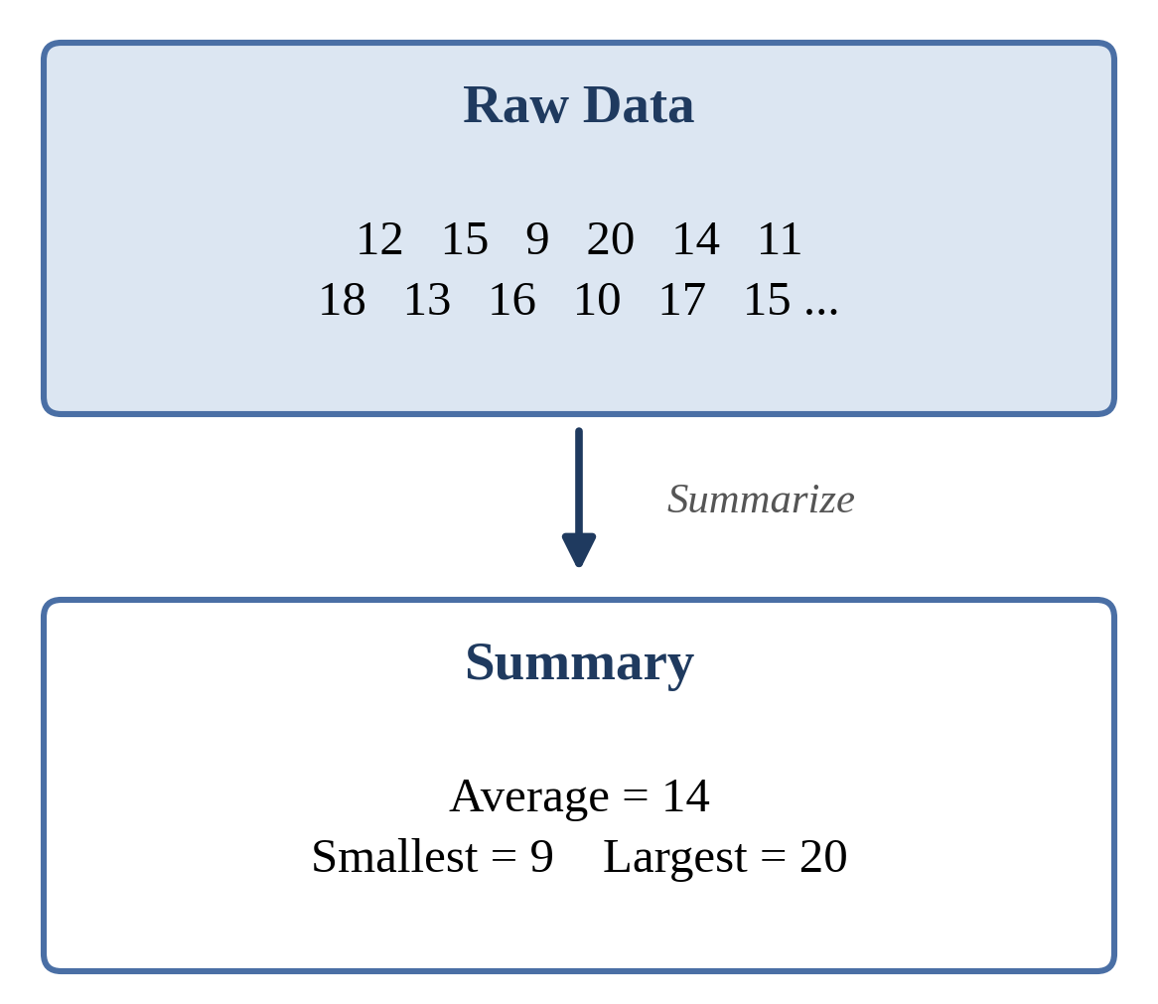
What is Data Summarization?
Turning many numbers into a few simple ones
Example: marks of 100 students become one average mark
It saves time and makes data easy to understand
It helps us compare groups quickly

Slide 5
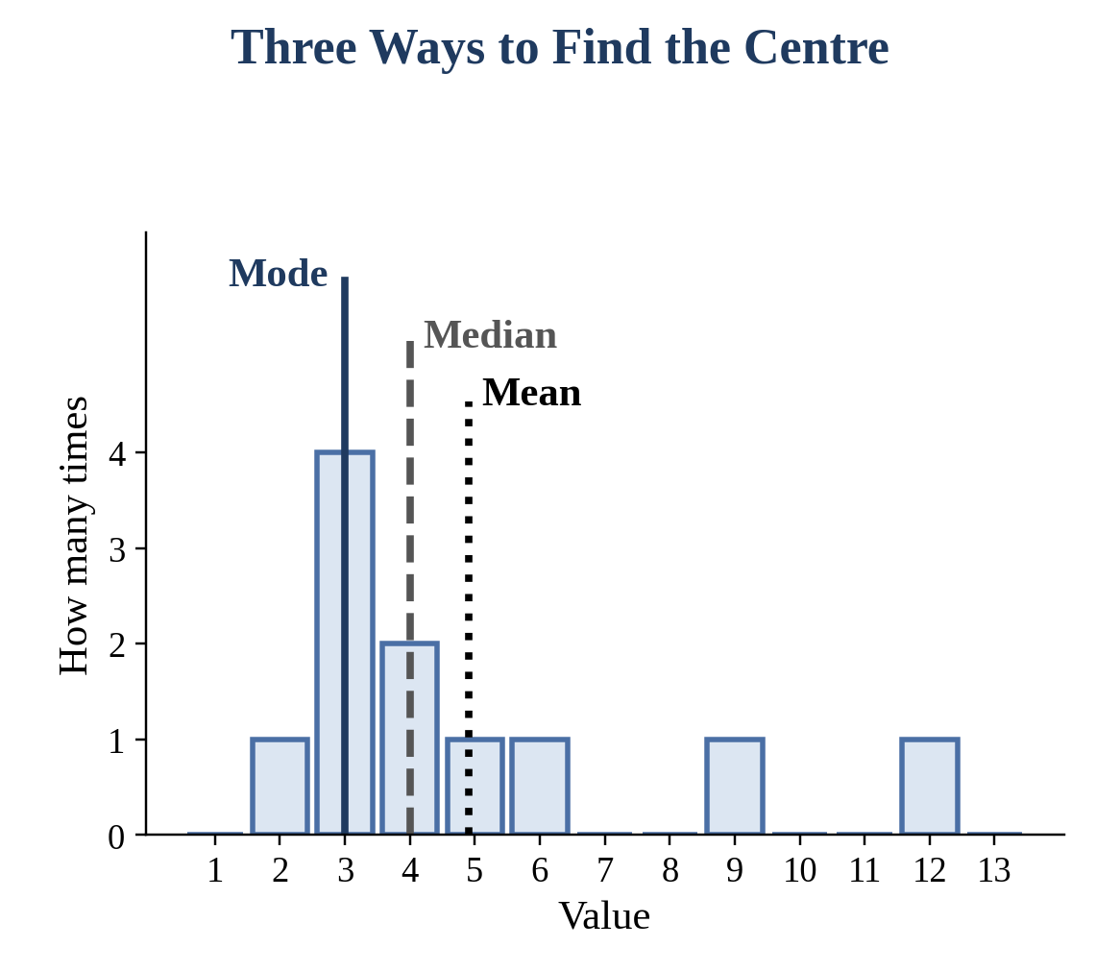
Finding the Centre of Data
Mean: add all values and divide by how many there are
Median: the middle value after sorting
Mode: the value that appears most often
Each one tells us what is typical

Slide 6
Spread: How Different Are the Values?
Range: biggest value minus smallest value
Variance: how far values are from the mean, on average
Standard deviation: the most common way to show spread
Small spread means values are close together
Large spread means values are far apart

Slide 7
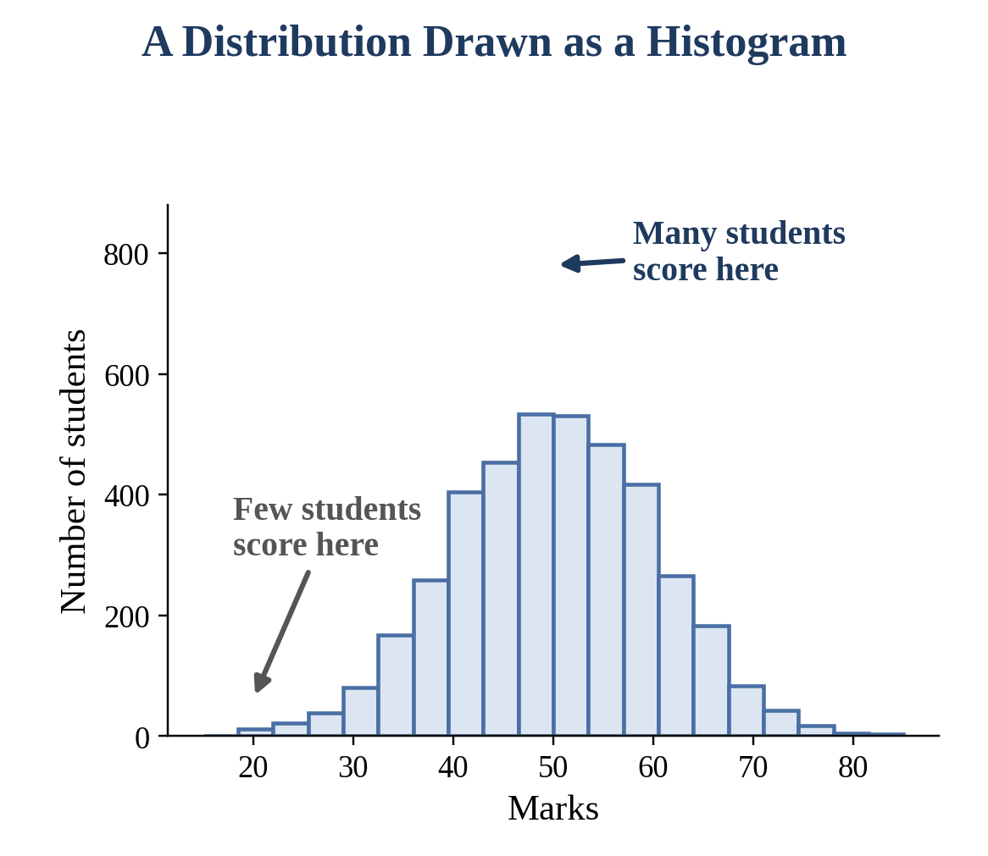
What is a Distribution?
It shows how often each value appears
We usually draw it as a histogram
Tall bars mean many values there
Short bars mean few values there

Slide 8
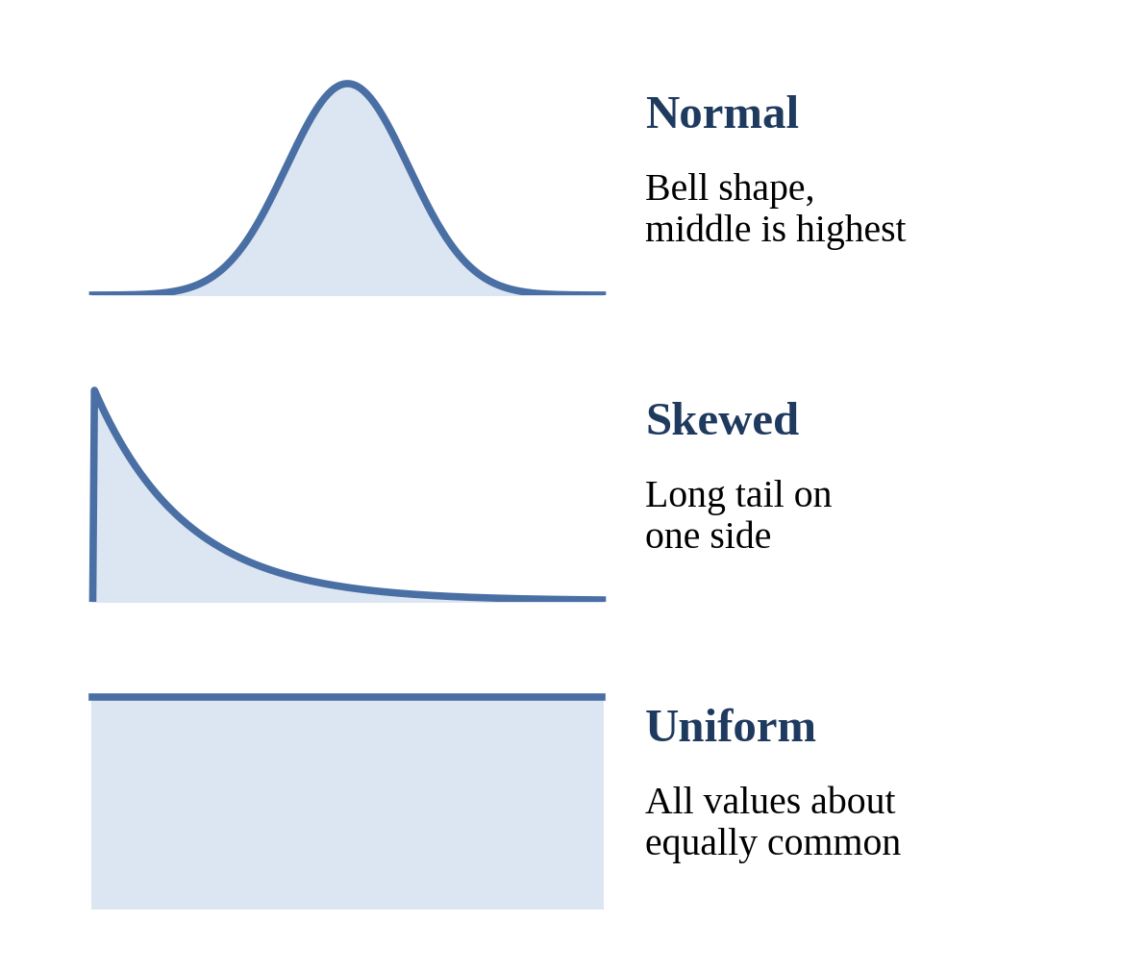
Types of Distribution
Normal: most values are in the middle
Skewed: a long tail on one side, like income
Uniform: all values are equally common
For skewed data, the median is a safer centre than the mean

Slide 9
Showing a Summary with Tables and Charts
Summary table: smallest, largest, mean and median
Histogram: shows the shape of the distribution
Box plot: shows median and spread in one picture
Bar chart: compares different groups
Good charts make data easy for everyone to read

Slide 10
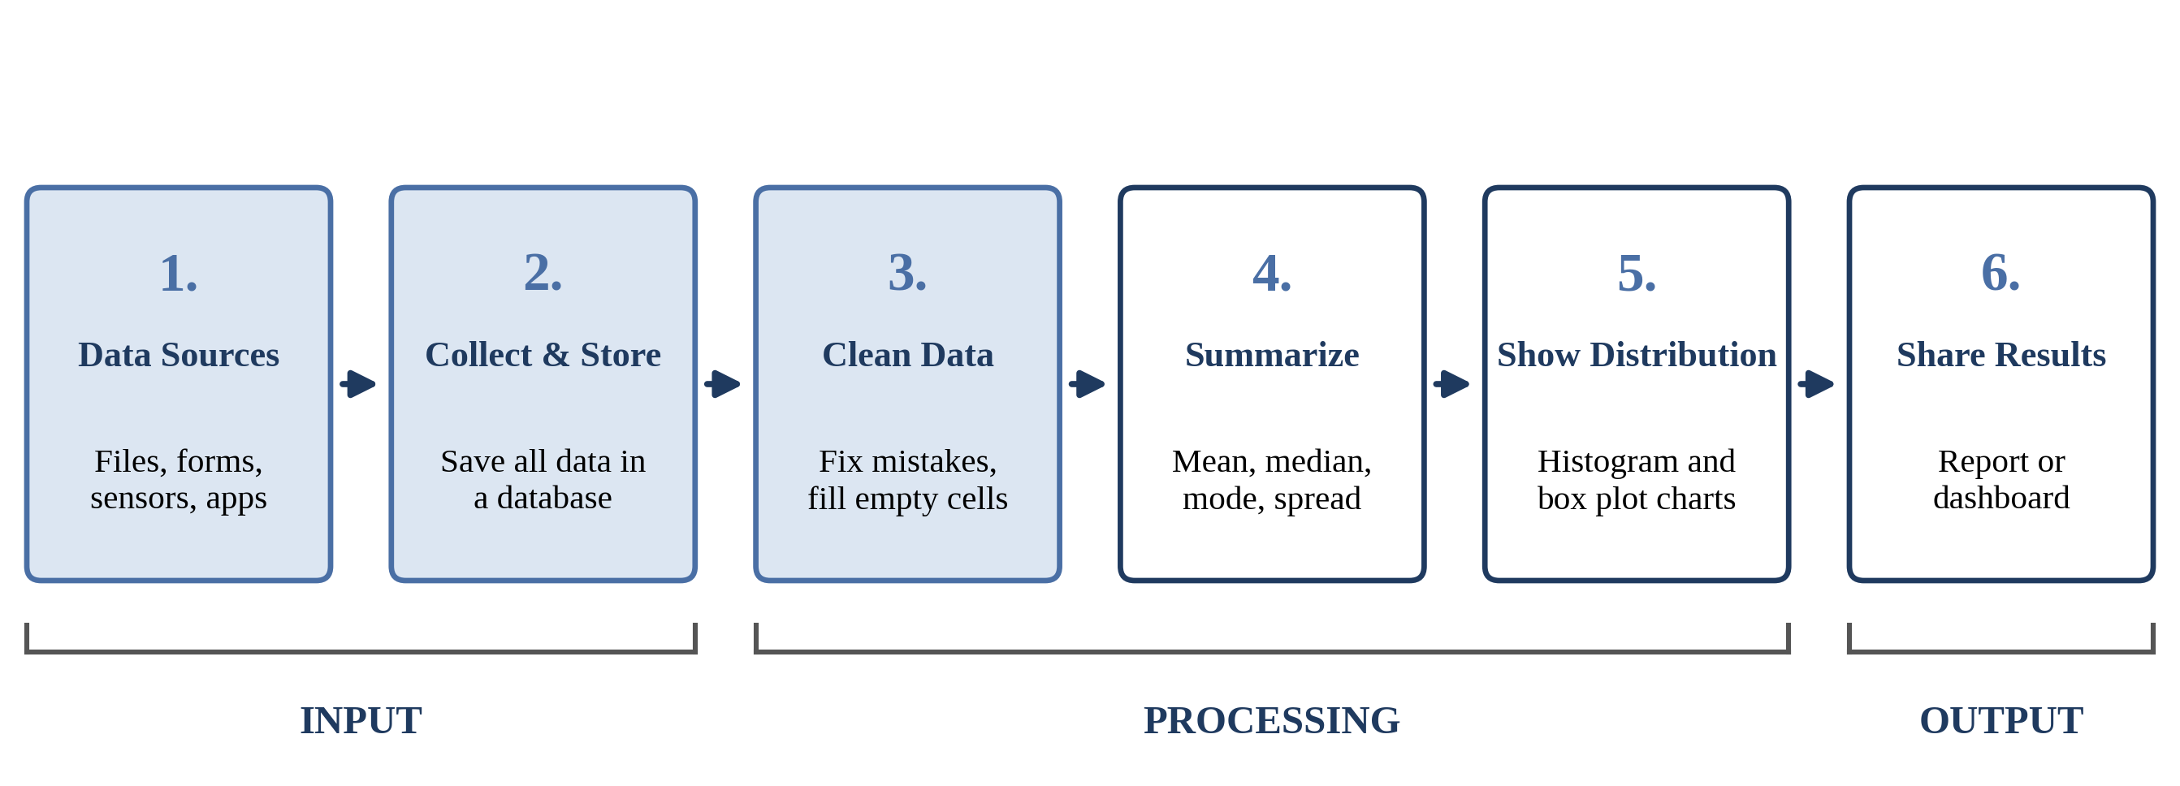
System Architecture: Data to Summary
Data moves from left to right until it becomes a report.

Slide 11
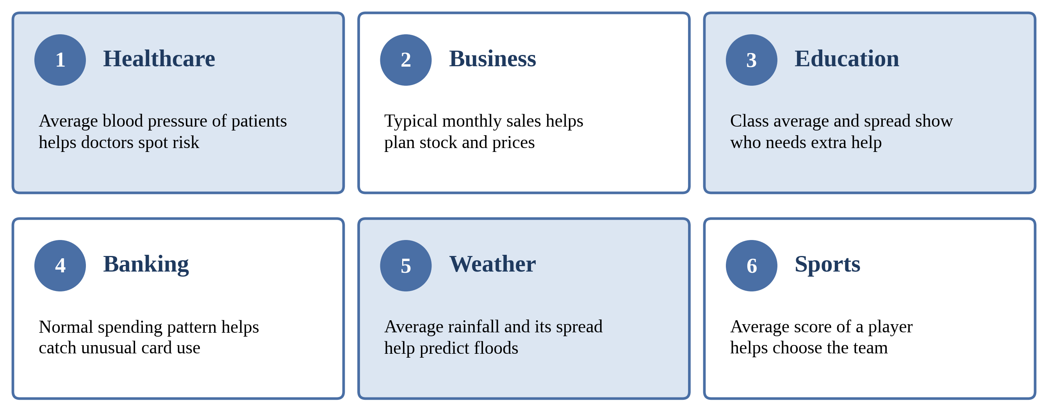
Applications in Real Life
Summaries and distributions help many fields.

Slide 12
Conclusion
Summarization turns big data into a few key numbers
Mean, median and mode show the centre
Range and standard deviation show the spread
Distribution shows the shape of the data
Thank you! Any questions?

Slide 13
THANK YOU

